Slide 1
INTRODUCTION TO SAP CLOUD PLATFORM

Slide 2
What is SAP Cloud Platform?
Platform as a service(PaaS)
Innovative cloud deployment and development platform
Build, extend and integrate business applications in the cloud.
Supported by multiple cloud infrastructure providers.

Slide 3
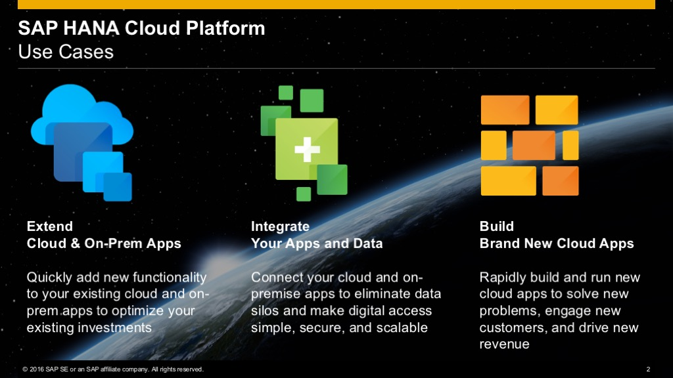
SAP Cloud Platform – Main use cases

Slide 4
Environments in SAP Cloud Platform
Cloud Foundry
Neo

Slide 5
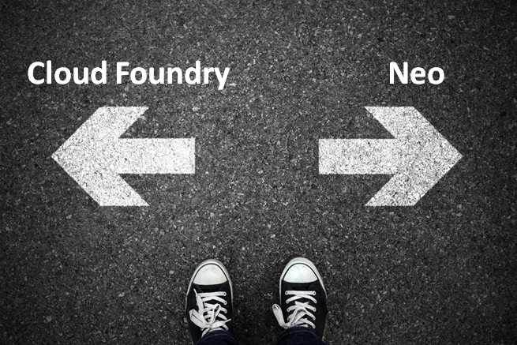
Which environment to use?

Slide 6
Cloud Foundry Environment
Open source platform maintained by Cloud Foundry environment.
Multiple run times like Java, Node.js.
We can bring in our own languages.
IoT, Machine learning scenarios and develop applications using SAP HANA extended application services advanced model.
Multiple data centers like GCP, Azure and AWS.
CF supports Business Application Studio

Slide 7
Neo Environment
Java, HTML5 and SAP HANA XS Applications.
It supports only SAP data center.
SAP Web IDE Full Stack.

Slide 8
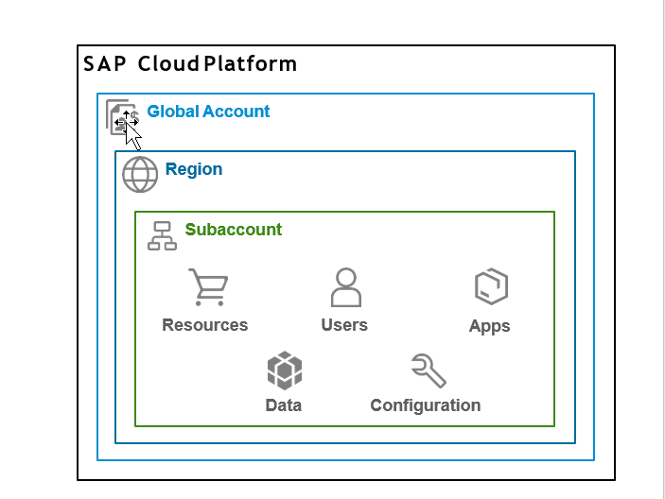
SAP Cloud Platform Accounts
Global accounts and sub accounts in SAP Cloud Platform are the way in which all of your activities in SAP Cloud Platform are structured.

Slide 9
Global Account
Realization of contract made with SAP.
Region and environment independent.
Two type of Global Accounts
Enterprise Account (paid)
Trial Account (free)
All metrics, billing, quota and resources done for a Global Account.

Slide 10
Subaccount
A Global Account can host multiple Sub Accounts.
Subaccounts in a Global Account are independent of each other.
Each subaccount is associated with a region and independent of our own location.
Spaces can be configured inside a subaccount for different business needs, or development teams according to the use cases.
The entitlements and quotas that have been purchased for a Global account have to be assigned to the individual sub accounts.

Slide 11
Regions
Represents a geographical location where applications, data and services are hosted.
A region is associated with one data center.
Provided by SAP or by Infrastructure-as-a-Service(IaaS) partners like Amazon Web Services (AWS), Microsoft Azure, Alibaba Cloud and Google Cloud Platform (GCP).
Region is chosen at the subaccount level.
For each subaccount we choose exactly one region and one environment.
For each region there is a different API Endpoint.
api.cf.us20.hana.ondemand.com – US West
api.cf.eu10.hana.ondemand.com – Europe (Frankfurt)

Slide 12
Trial Accounts
Free of charge with limited services and functionality.
One trial account per user.
Expires after 30 days, but can be extended to a limit of 90 days.
No service – level agreement with regard to availability of the platform.
Applications stop automatically after a certain period of time.

Slide 13
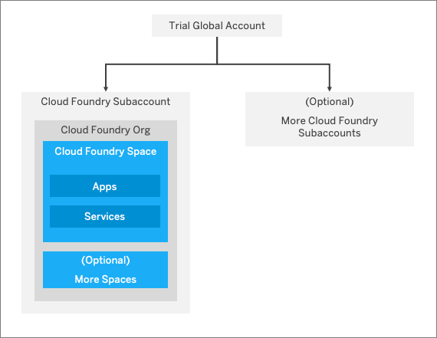
Trial Account Structure

Slide 14
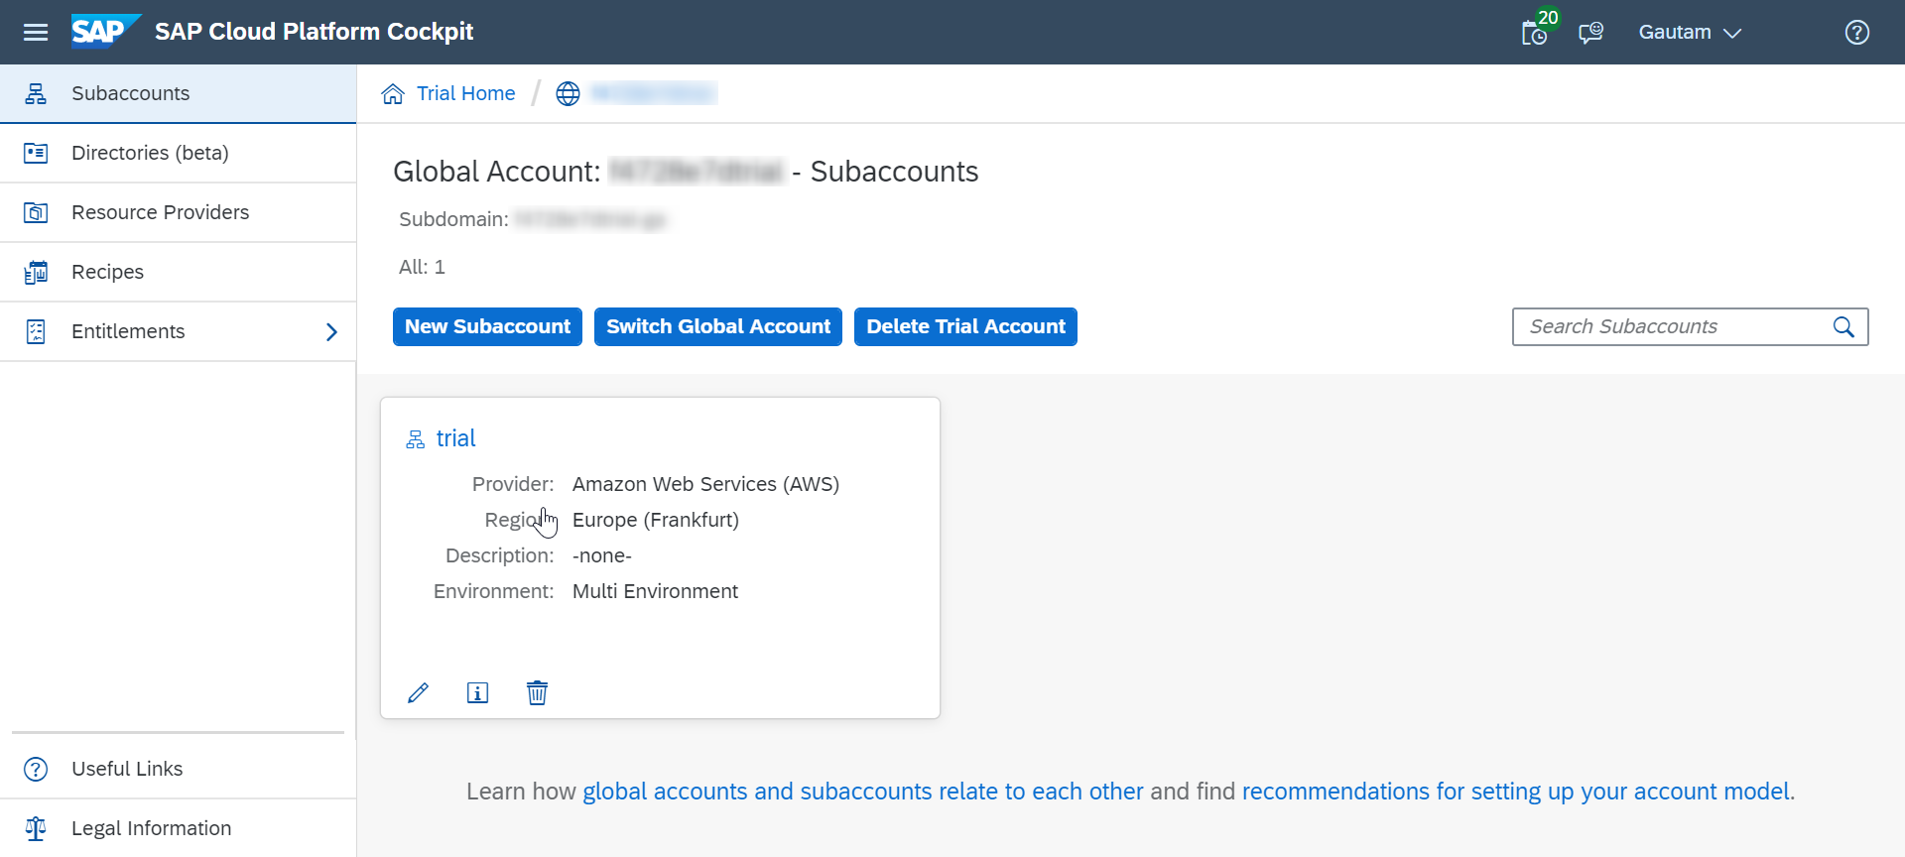
This is how trial global account looks in SAP Cloud Platform Cockpit.

Slide 15
SAP Cloud Platform cockpit
SAP Cloud Platform cockpit is the consolidated destination for operational needs.
Entry point to SAP Cloud Platform on the web.
Monitoring of resources, databases and applications.
Entire administration can be done from SAP Cloud Platform cockpit.

Slide 16
Navigation in the cockpit
There are 2 ways of navigating inside the cockpit
Using the left-hand side navigation
Using the bread-crumbs at the top of the page.
There are certain actions you can perform at each hierarchical level (global account, sub accounts, spaces etc.) called scope.
Inside the global account we can add members, create more subaccounts, add entitlements and quotas to subaccounts. These actions come under the global account scope

Slide 17
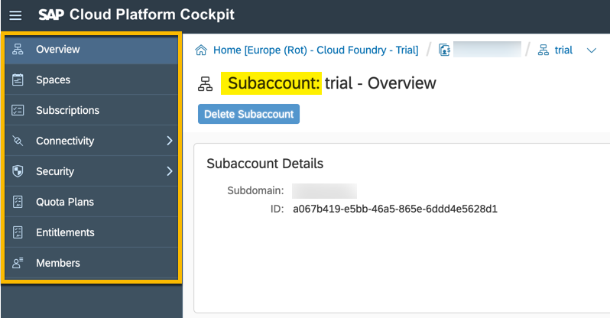
Left hand–side navigation
Cloud Foundry Subaccount scope:

Slide 18
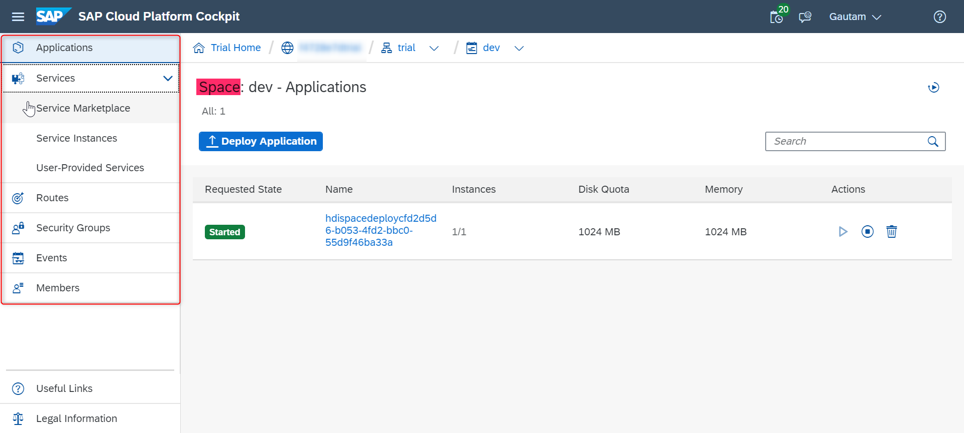
Cloud Foundry Space Scope:

Slide 19
Breadcrumbs
You can navigate back using the breadcrumbs at the top.
Coincide with the hierarchical path you have travelled in order to reach your current scope in the cockpit.
The last item in the breadcrumbs always represents the scope you find yourself in at the moment
To go back follow the breadcrumbs to retrace your steps.

Slide 20
Trial Home : - trial homepage
Global account – All your subaccounts and entitlements.
Represents your subaccount
Represents your space.
Your application running inside the space. Your current scope.

Slide 21
Services in the Cloud Foundry Environment
Create service instances and bind them to applications within that space.
A single instantiation of service running on SAP Cloud Platform.
Created using a specific service plan.
A service plan is a configuration variant of a service.
To integrate services with applications, the service credentials must be delivered to the application.
Bind service instances to your application to automatically deliver these credentials.

Slide 22
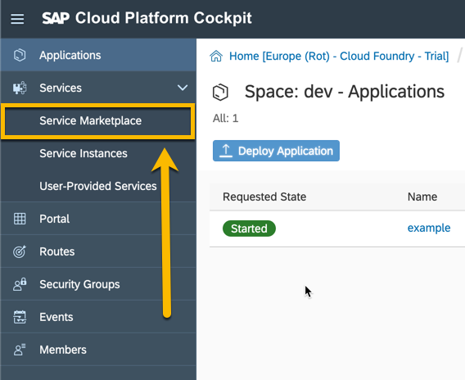
To create a service instance
Navigate to your space in the Cloud Foundry environment where you want to create the instance and choose Service Marketplace from the left hand-side navigation.

Slide 23
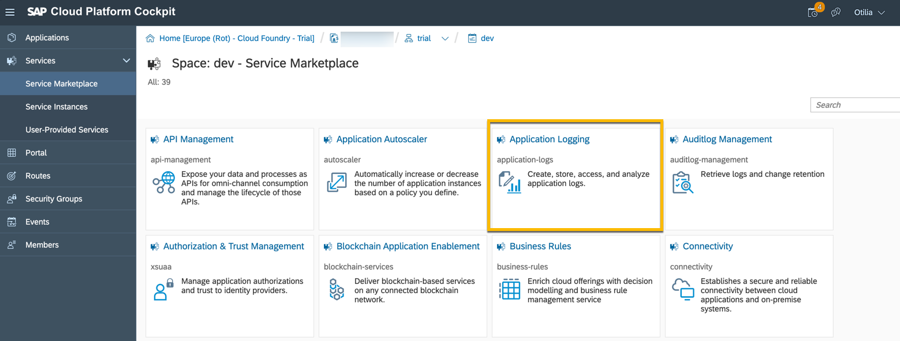
2. Choose the service for which you want to create an instance (let’s choose Application Logging as an example).

Slide 24
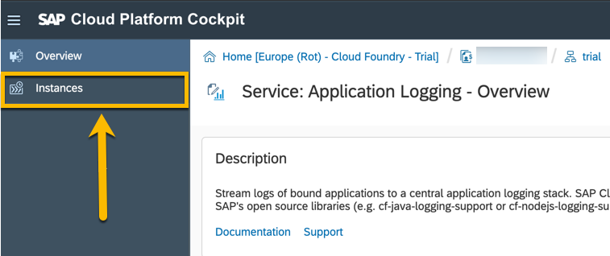
3. In the left hand side navigation choose instances.

Slide 25
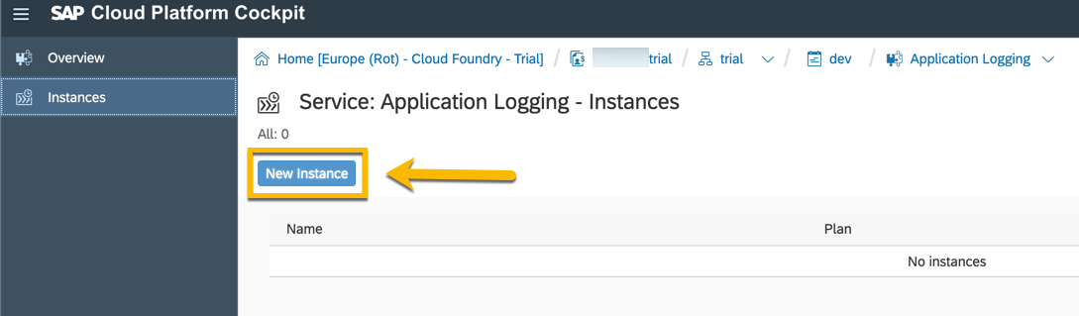
4. Click on the new instance button

Slide 26
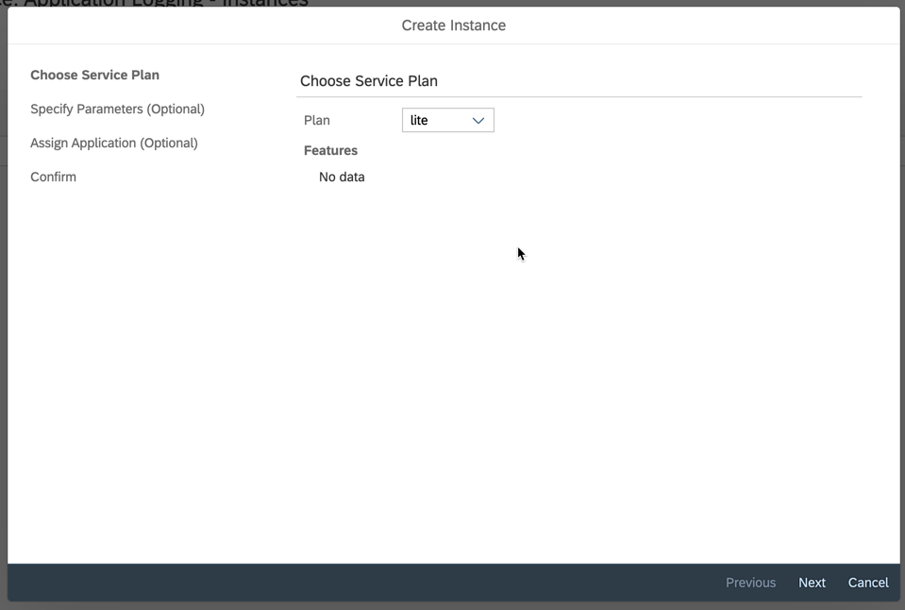
Follow the wizard to finalize the creation of the instance. This includes choosing a service plan and optionally adding parameters and an application to bind the instance to.

Slide 27
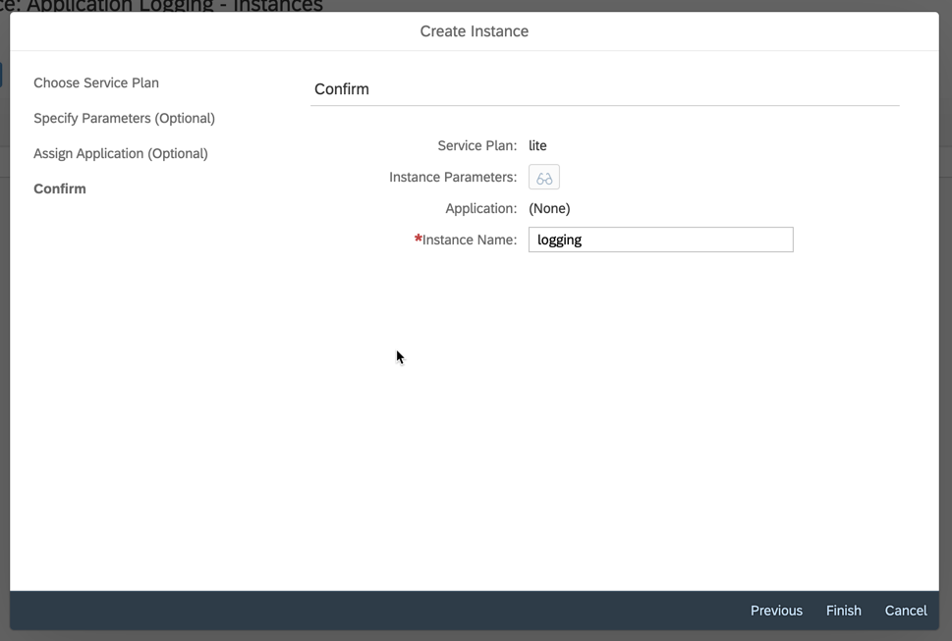
Finally enter a name for your instance and choose finish

Slide 28
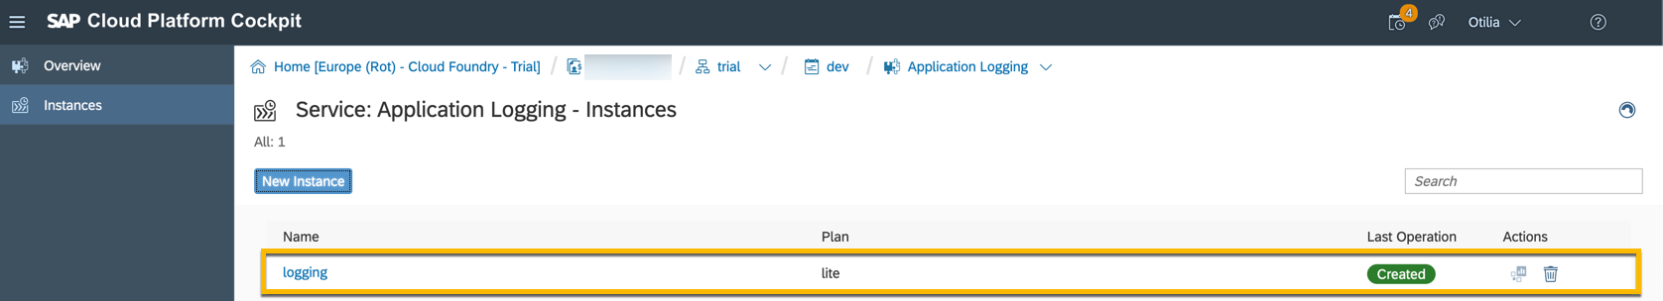
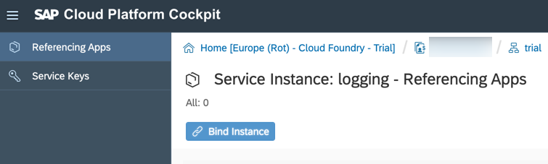
Your new instance will appear as shown below.
You can then click on it to bind it to an application if not done already.

Slide 29
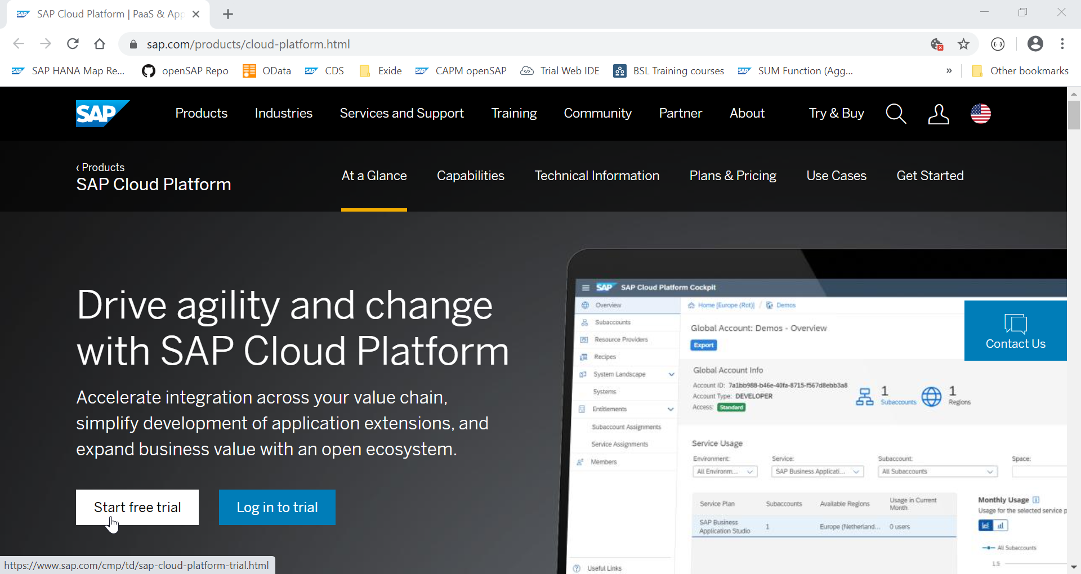
CREATING A FREE TRIAL ACCOUNT

Slide 30
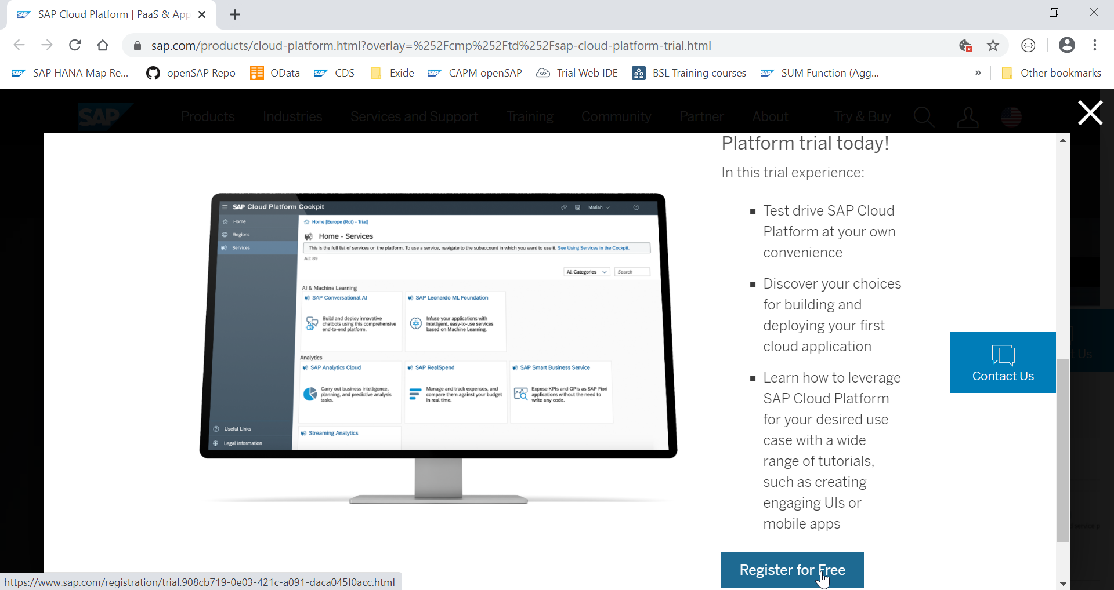

Slide 31
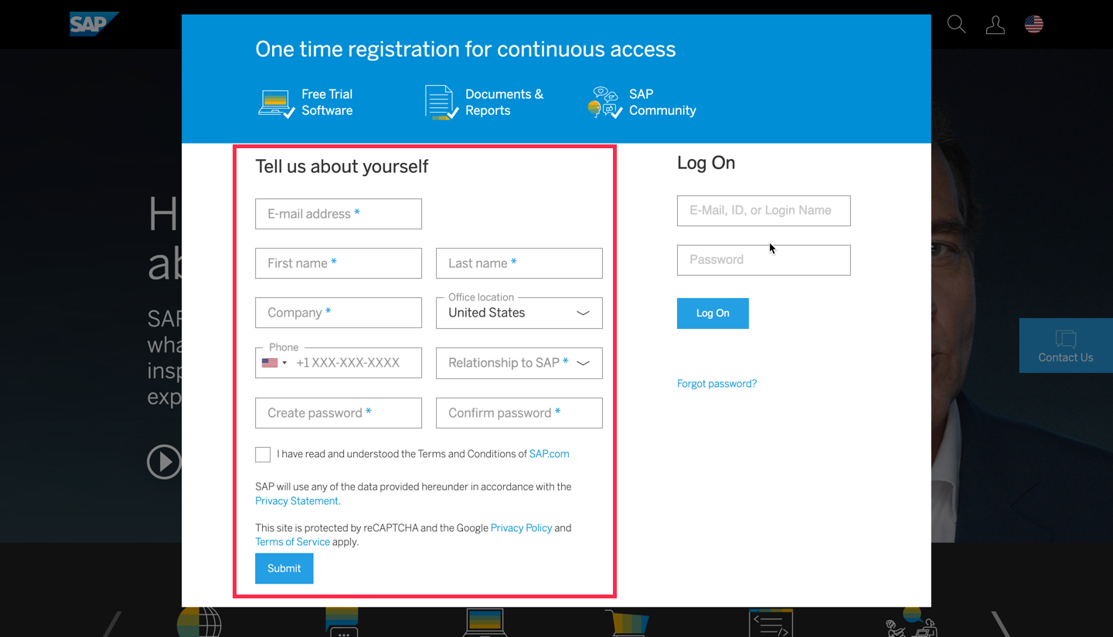
If you don’t have an account already, fill in the details on left-hand side of the dialog and click submit

Slide 32
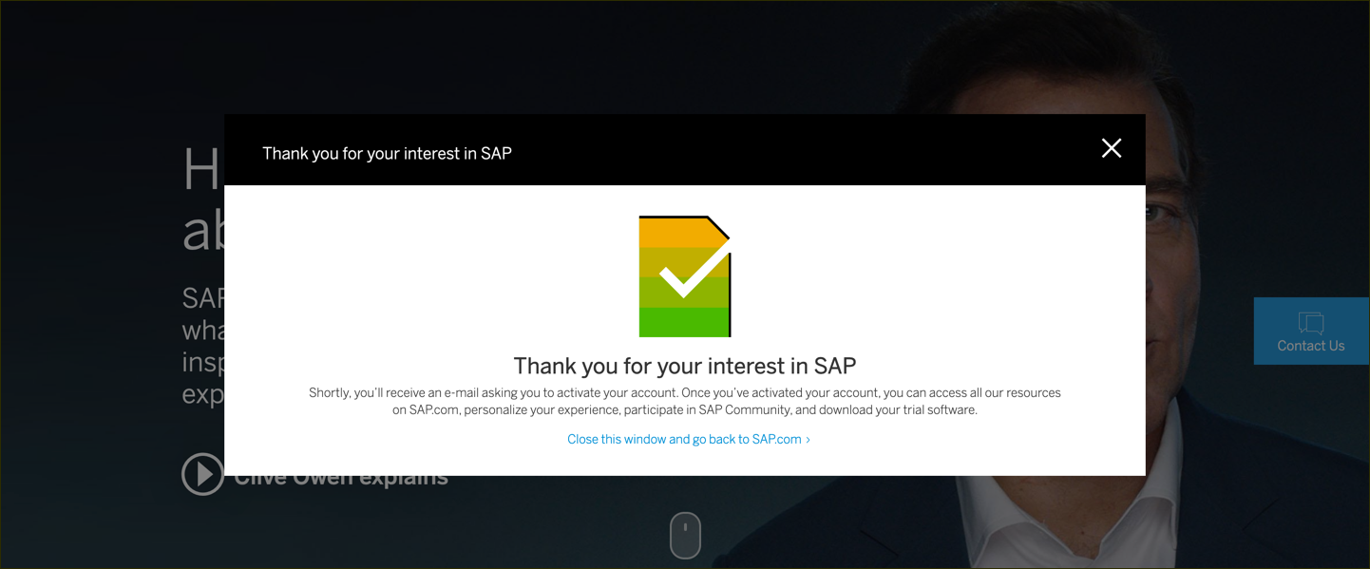
You will get an email saying activation link has been sent to you.

Slide 33
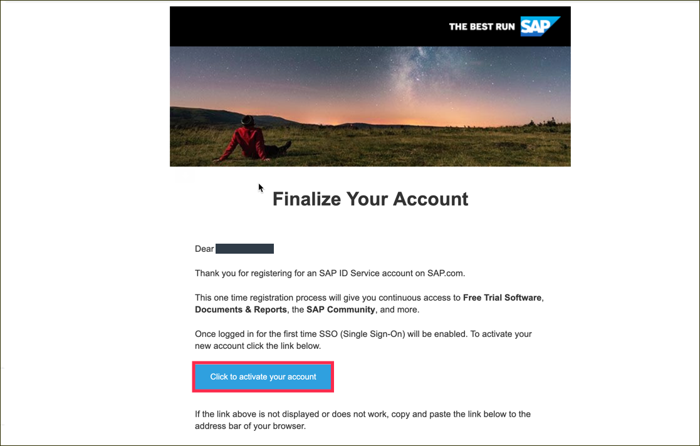
Click to activate your account

Slide 34
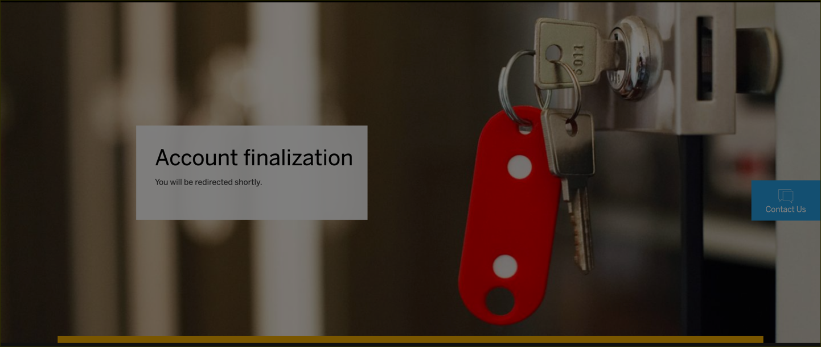
After activating your account you will see the following screen.

Slide 35
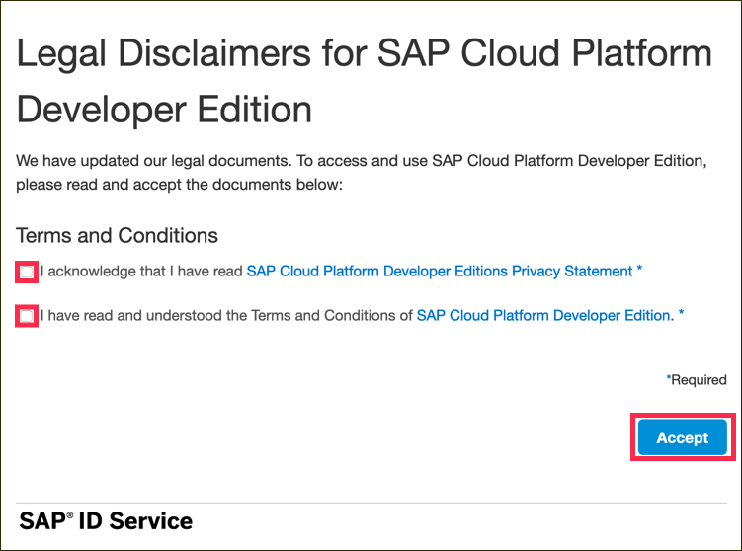
Go to SAP Cloud Platform page and click on Log on

Slide 36
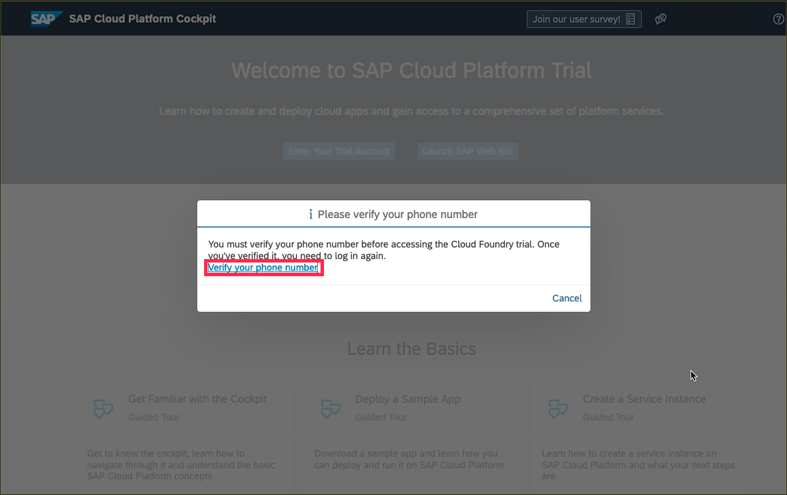
Verify your account with a phone number.

Slide 37
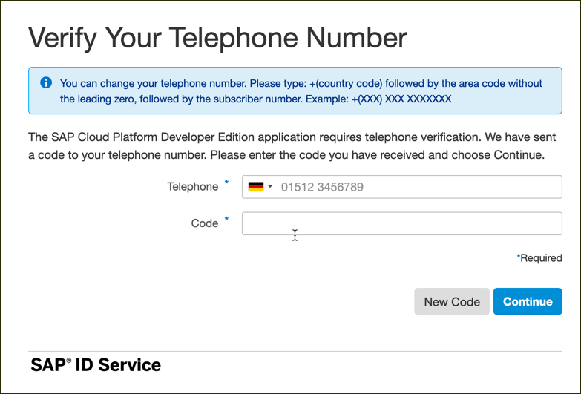
Enter your phone number and click New Code to retrieve a code

Slide 38
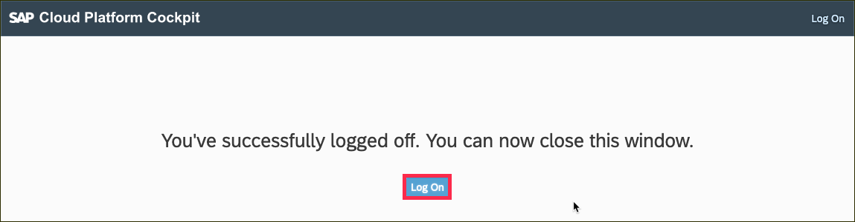
Click on Log on to log on to your verified account.

Slide 39
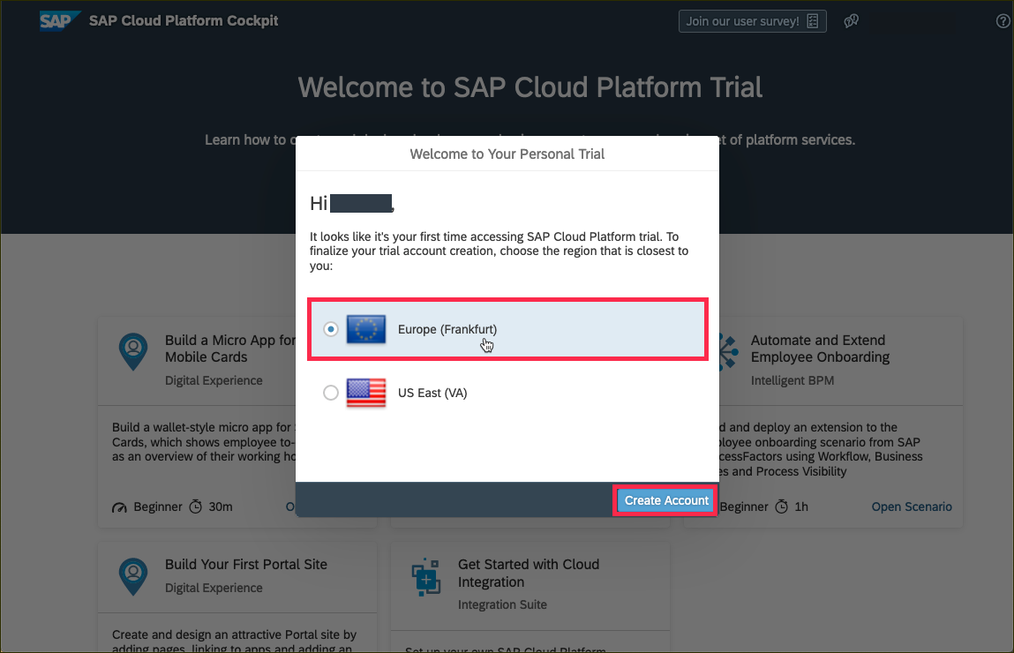
Create a subaccount which lives in a geographic region. Choose one of regions from this list.

Slide 40
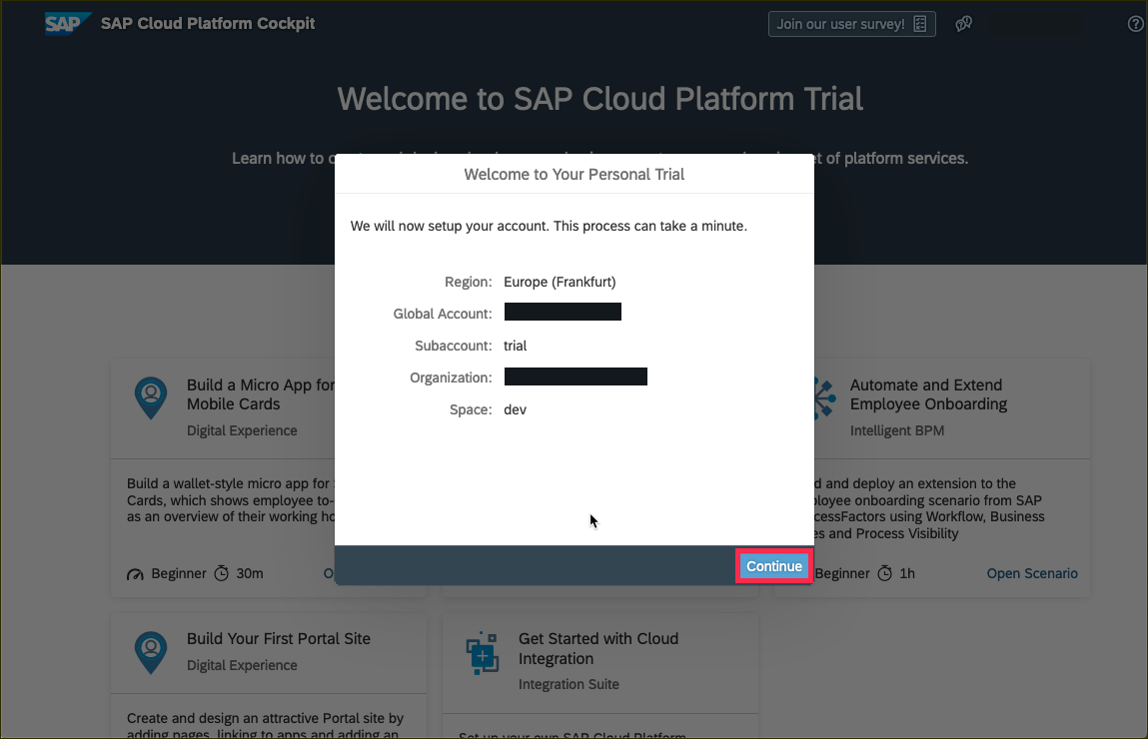
You will then see a dialog box while the account is set up. When complete, the dialog box will look like this. Click Continue to close to popup.

Slide 41
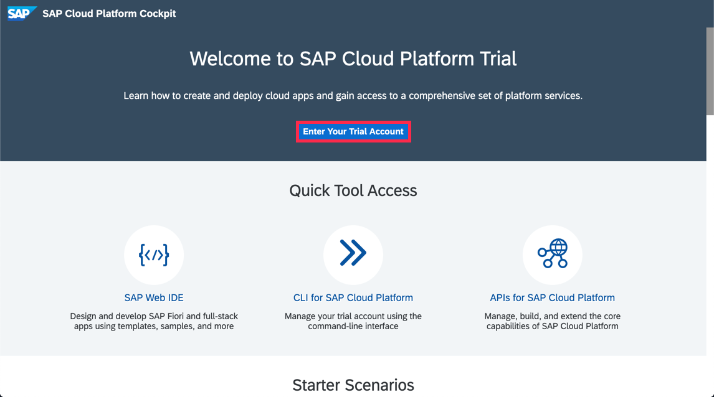
Click on Enter Your Trial Account to see your global account.

Slide 42
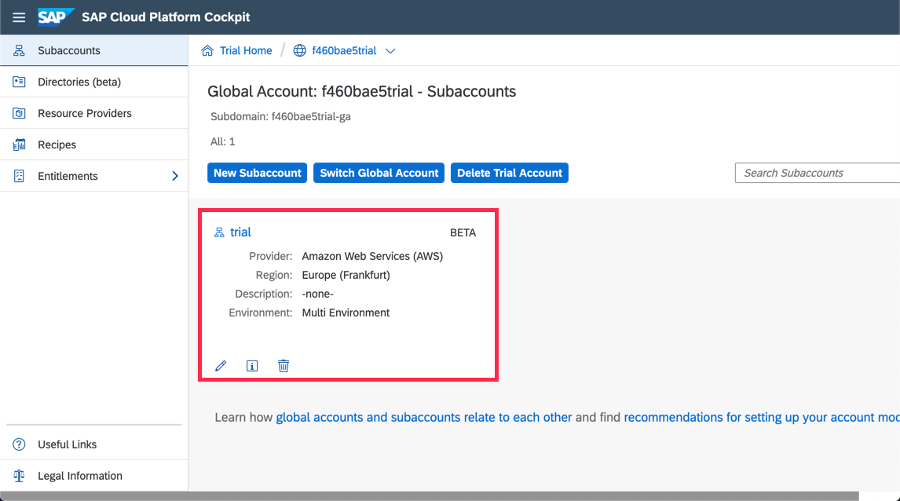
The global trial account contains one subaccount and space. Navigate to subaccount by clicking on the tile named trial (this name may vary if you created the subaccount manually).

Slide 43
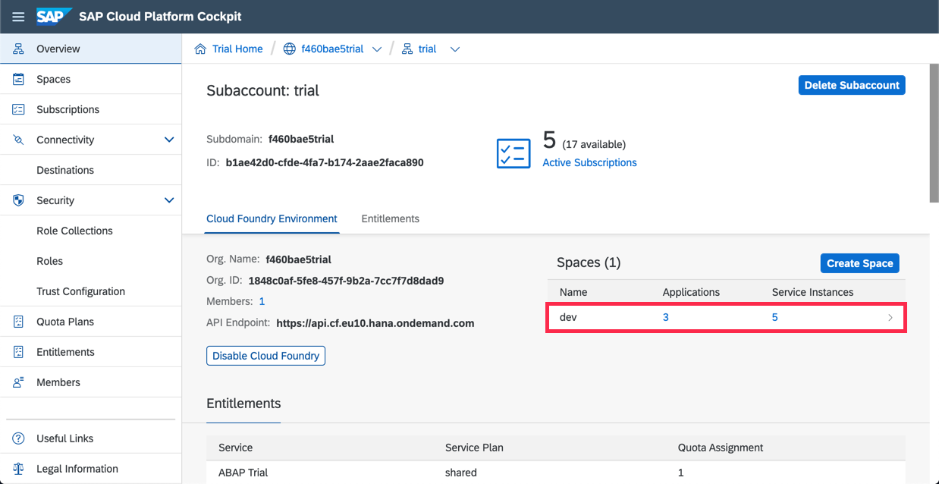
To get to the space, in which your applications and services live, click on the dev space.

Slide 44
Introducing SAP Web IDE
SAP Web IDE is web – based integrated development tool that simplifies end-to-end development of business applications.
tooling, prototyping, developing and deploying the application and make it available to end users.
Build SAP Fiori, mobile and Internet of Things (IoT) applications, even supports scenarios such as SAP S/4 HANA extensions.

Slide 45
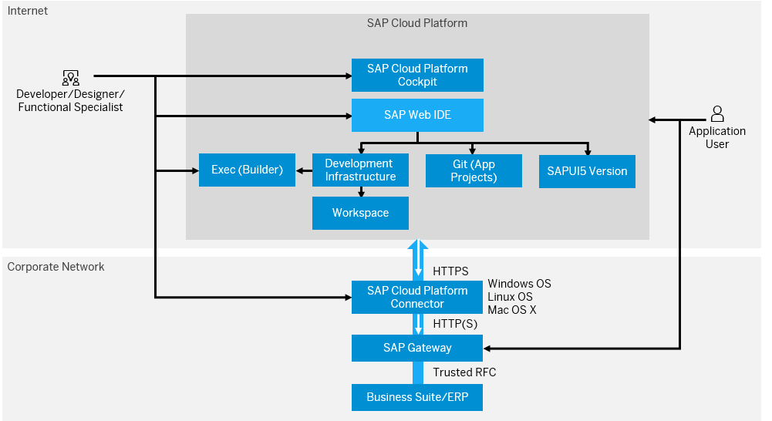
Architecture of SAP Web IDE

Slide 46
Component | Description
SAP Cloud Platform | PaaS to build, extend and integrate business applications in the cloud.
SAP Cloud Platform Cockpit | Central point of access in SAP Cloud Platform to manage all applications, resources, privileges, roles and users.
SAP Web IDE | Integrated development environment to build full stack business applications
SAP UI5 | SAP’s own User Interface technology
Git | Distributed Version Control System for source code management.
SAP Cloud Platform Connector | To connect on-premise SAP systems to SAP Cloud Platform with minimal configurations.

Slide 47
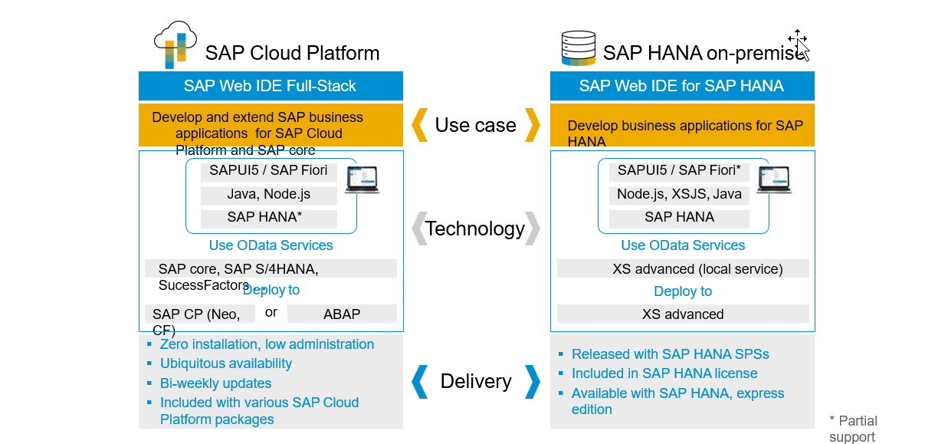
Delivery Options

Slide 48
SAP Web IDE – features and benefits
SIMPLE - no cost, no complex infrastructure, reduced effort.
INTEGRATED – extend and integrate services to create intelligent business applications.
PRODUCTIVE – focus only on domain logic and kick start development.

Slide 49

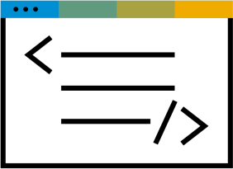



Development process overview
Design
Build
Test
Deploy
Design
Develop
Build
Test
Deploy

Slide 50
Design
Jump-start your designs with one of many prototype example from the gallery
Collaboratively develop prototypes with your project team and engage end users for feedback
Easily import the Build prototype to SAP Web IDE and use it as a starting point for your SAP Fiori app

Slide 51
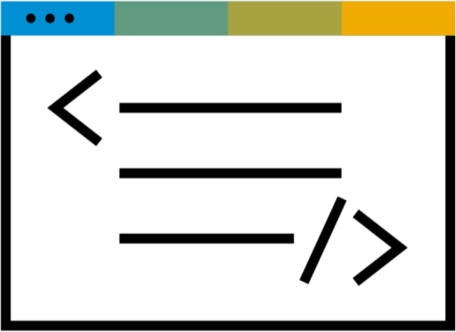
Develop
Templates and wizards
Visual/code editors
Instant preview with real/mock data Debugging
SAP and open source technologies Source control management

Slide 52


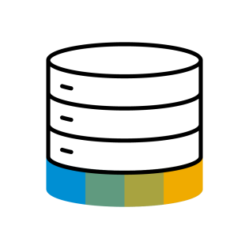

Build
Building UI Applications
Use Grunt open source task runner to build UI app
Building Business Applications
Build a deployment package from your
UI, database, and business-logic
modules sharing the same lifecycle

Slide 53

Test
Leverage integrated testing capabilities to validate your application’s functionality and compatibility
Test Authoring
Wizard-based and code-based assistance for developing unit tests (UI, Java, Node.js) and integration tests (UI)
Test Execution
SAP Web IDE empowers developers to test and evaluate their app’s functionality during development

Slide 54


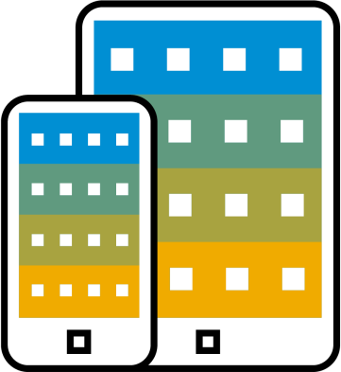
Deploy
Multiple options are available for a developer to deploy a new application or update an existing application on the target system and register it to the SAP Fiori launchpad on SAP Cloud Platform
SAP Cloud Platform
Neo, Cloud Foundry
SAPUI5 ABAP repository
SAP Mobile Platform
(for mobile applications

Slide 55
Additional Features
Zero installation and maintenance
Java and Node.js Debuggers.
Business Application Development.
SAP HANA database graphical editors.
Source code editor with code completion, validation and formatting.
Integrated Git source control.

Slide 56
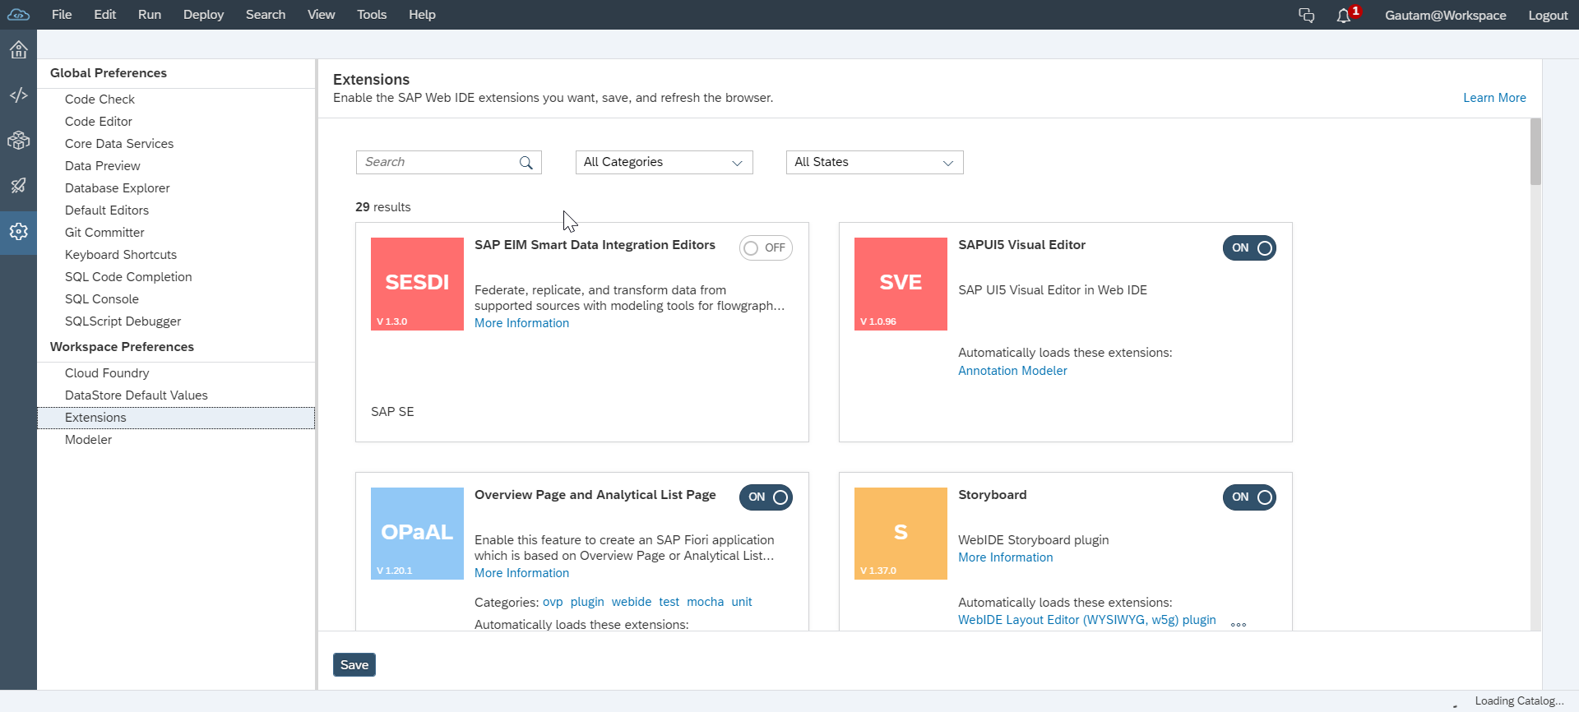
Extensions
To enable Preferences
Tools > Preferences > Workspace Preferences > Extensions
For example,
SAP HANA Database Development Tools extension needs to enabled to create design time database artifacts, such as data models, views or procedures.

Slide 57
Accessing SAP Web IDE
Go to SAP Cloud Platform Cockpit Home page
Click on SAP Web IDE
Bookmark the URL
Configure API Endpoint in Cloud Foundry settings in SAP Web IDE.

Slide 58
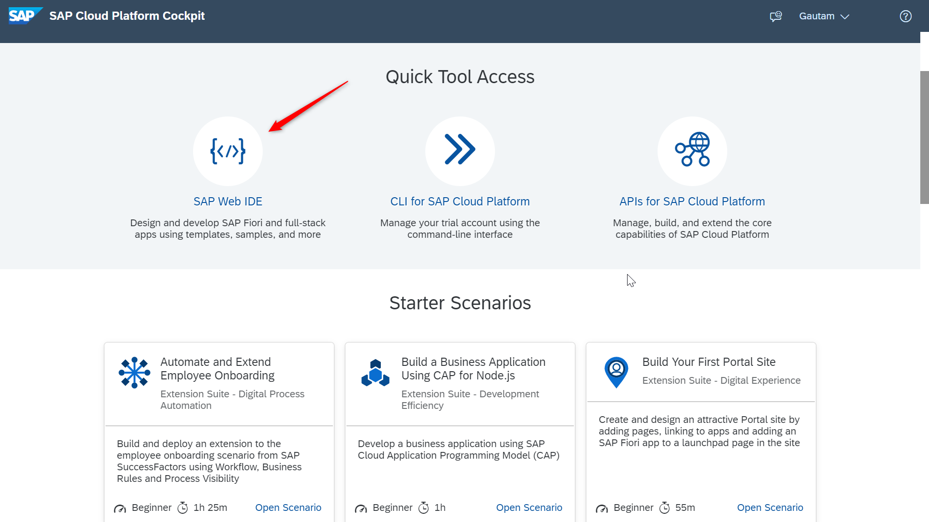
Go to SAP Cloud Platform Cockpit home page.

Slide 59
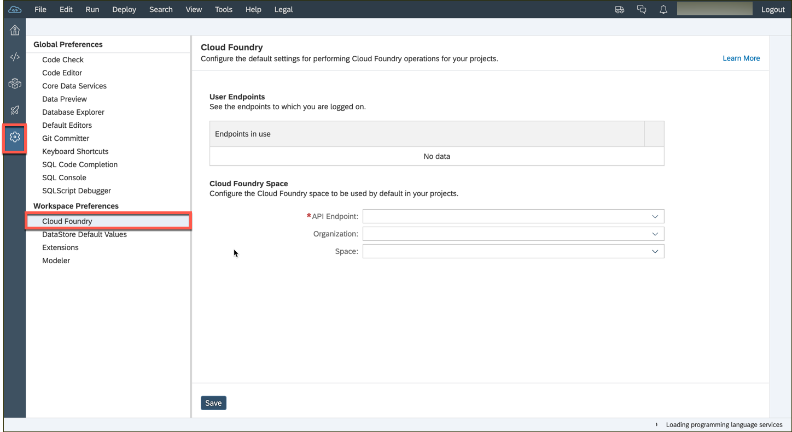
Go to Preferences > Workspace Preferences > Cloud Foundry

Slide 60
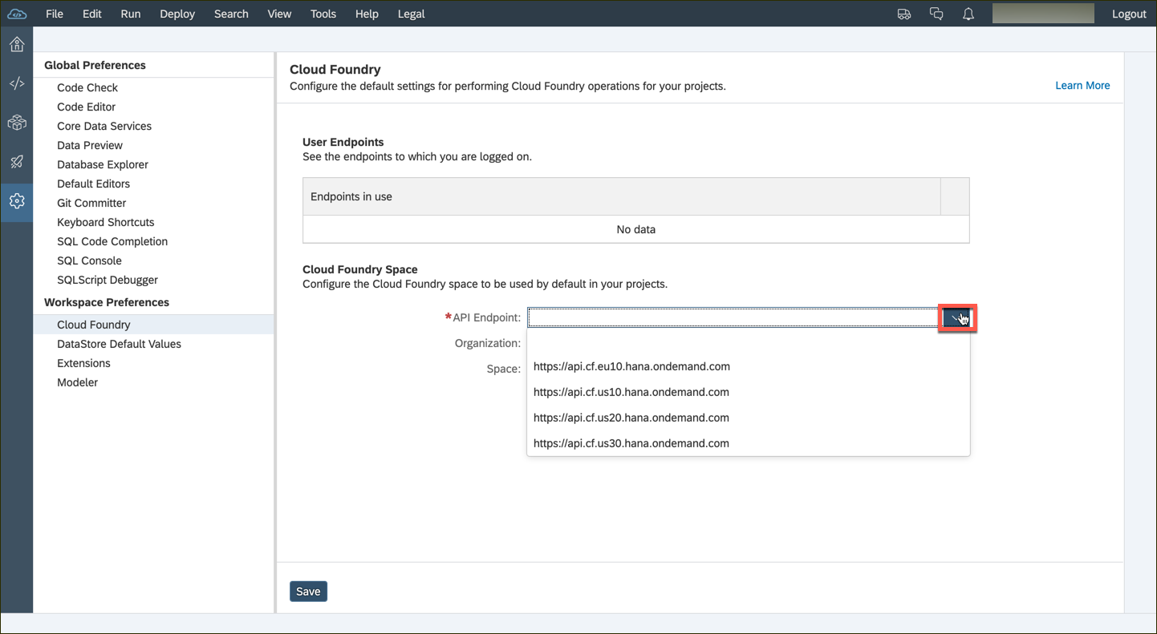
Configure the API Endpoint depending on the data center of your subaccount.

Slide 61
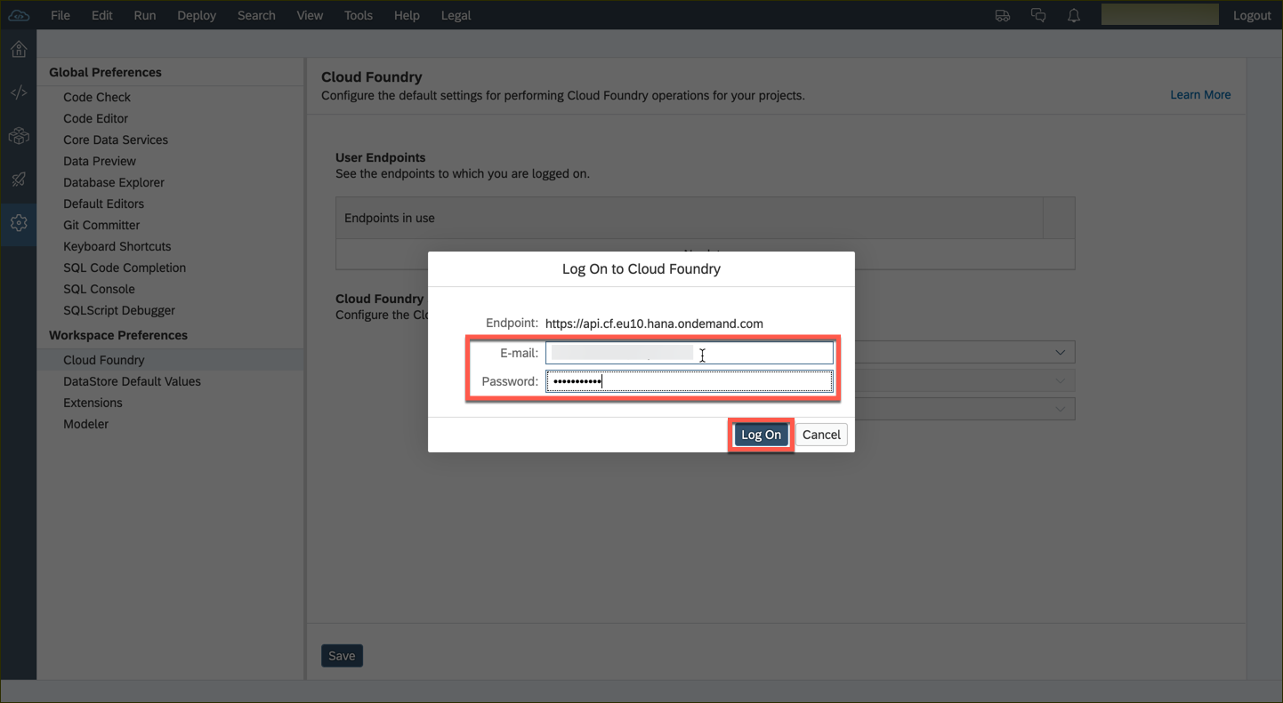
You might be prompted for your Cloud Foundry credentials. Enter the credentials you used for SAP Cloud Platform Cockpit.

Slide 62
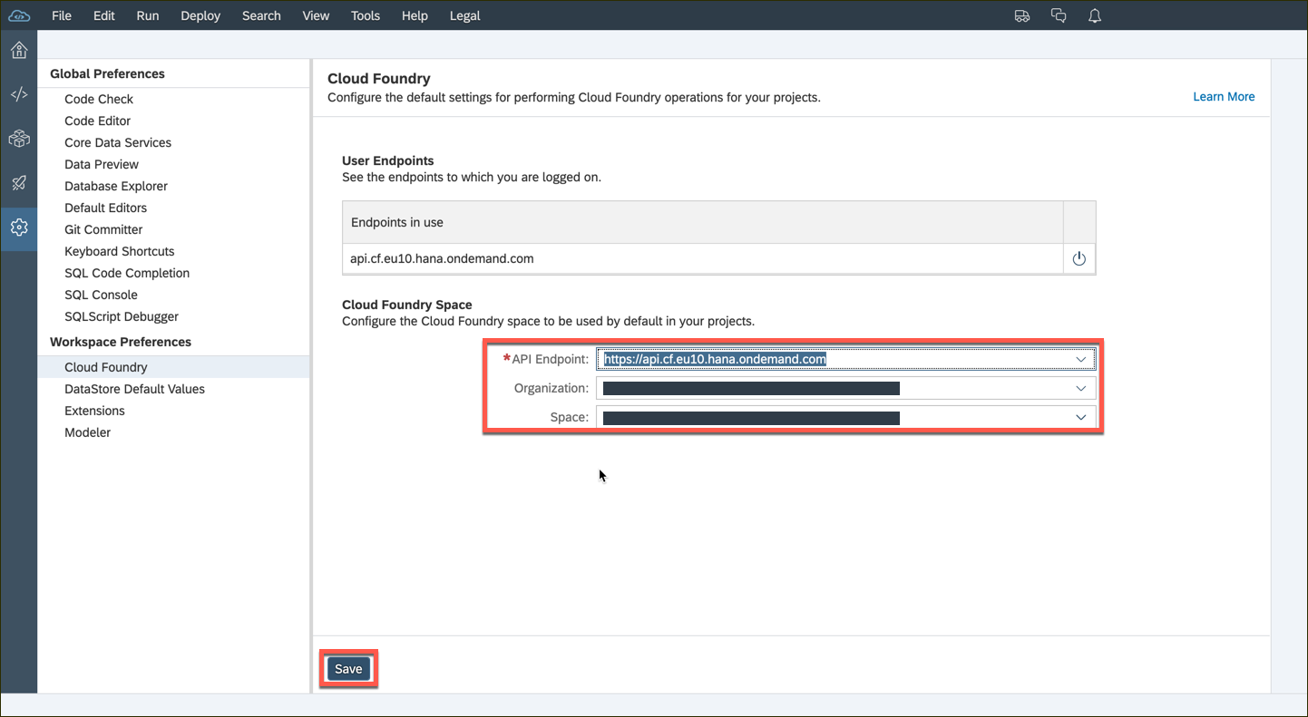
If there is a subaccount in the selected data center then the organization and space fields will be populated by default. You can change these values via the dropdown list. Hit the Save button thereafter.

Slide 63
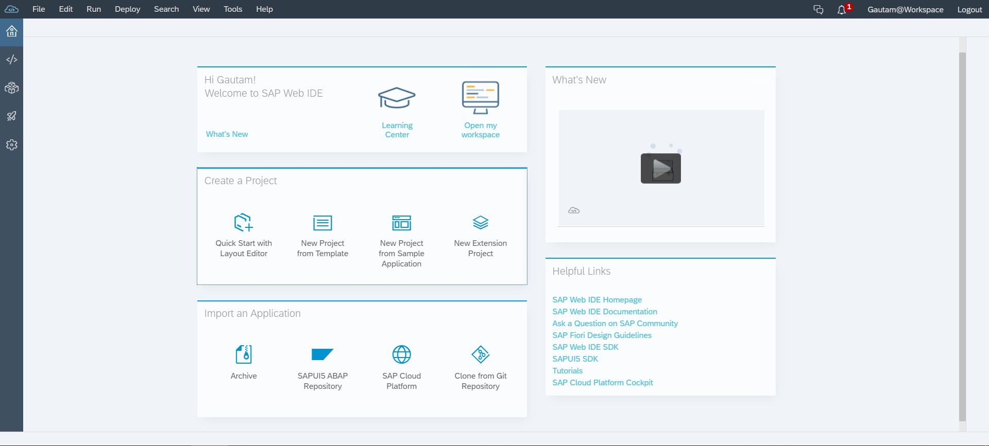
Home Screen of SAP Web IDE
Perspectives:
Home(Welcome)
Development
Database Explorer
Storyboard
Preferences
Quick and easy access to most common creation actions.
Link to external resources and tools

Slide 64
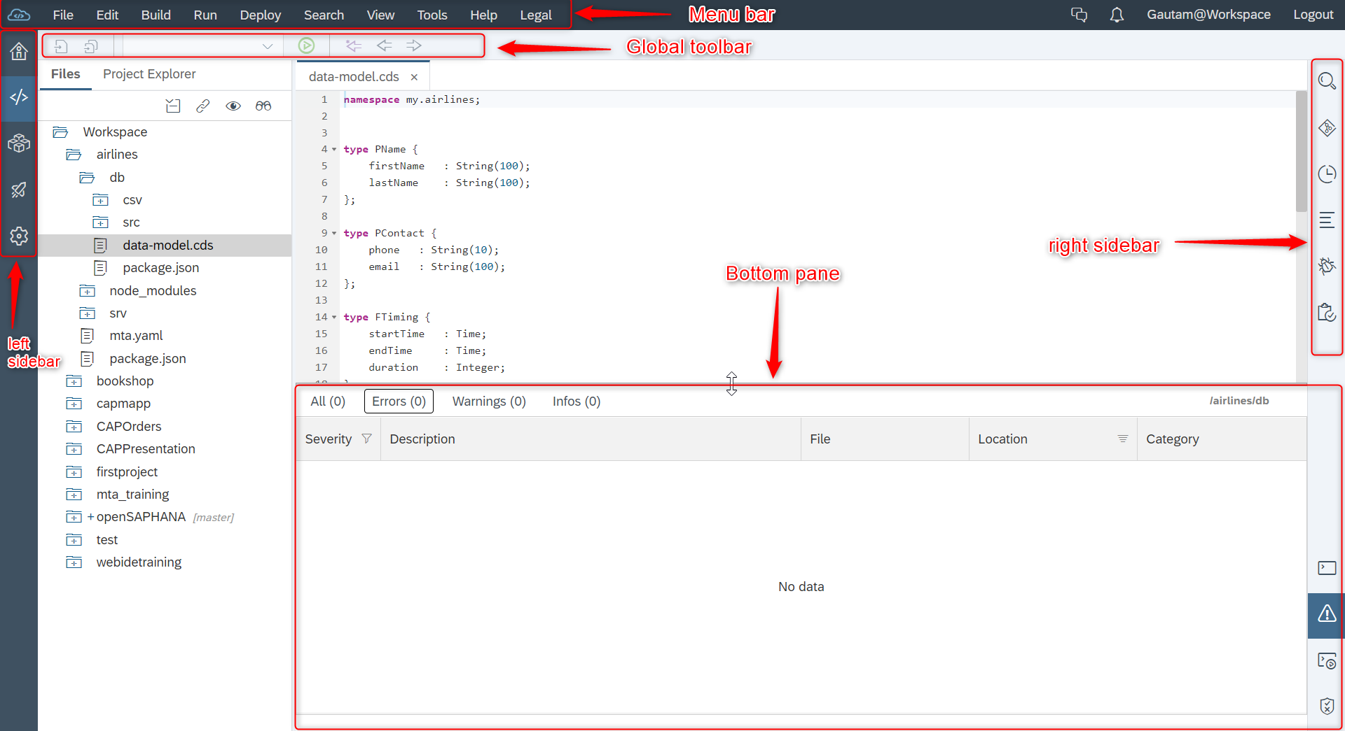
Navigating SAP Web IDE

Slide 65
Development perspective
Menu bar - Provides access to all operations available in SAP Web IDE.
Global toolbar - Depending on the item that is activated in the workspace, you can choose from the icons in the global toolbar (icons of actions that are not applicable are grayed out).
Left sidebar - Use the buttons to switch between the development workspace, the database explorer, and user preferences.
Right sidebar - Use the buttons to switch between the different panes available in SAP Web IDE (for example, Git pane, Debugger, and so on).
Bottom pane - Use the toggle buttons to display the console or the problems view.

Slide 66
Database Explorer Perspective
Menu bar - Different action items relevant to only database explorer perspective are available.
Global toolbar - open a SQL console and save any file action items.
Left sidebar - Use the buttons to switch between the development workspace, the database explorer, and user preferences.
Right sidebar - Use the buttons to switch between the different panes available in the database explorer.

Slide 67
SAP Business Application Studio
Tailored for efficient development of business applications for the Intelligent Enterprise.
Evolution of SAP Web IDE, the current development environment.
It is available as a service in SAP’s Cloud Foundry Environment.
Provides solution based on development spaces.

